Slide 1
Antialias

Slide 2
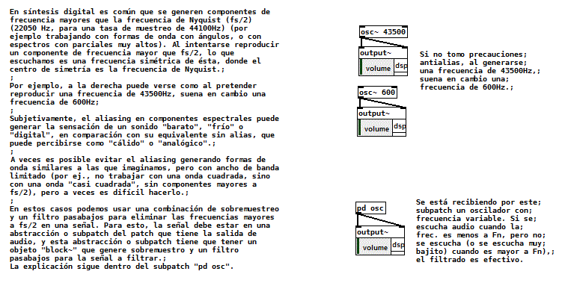

Slide 3
Subpatch
[pd osc]

Slide 4
